Slide 1

Networking
Slide Courtesy
Dr. Firoz Ahmed
Associate Professor
Department of ICE

Slide 2
Client-Server Model
Port 80
Client application
132.65.32.29
Server application
64.208.34.100
www.google.com
Client application
132.68.7.11

Slide 3
Port
A port is a term used to describe the process of taking a program that has been written for specific operating systems and moving it to another operating system.
A port in computer software is when a piece of software has been translated or converted to run on different hardware or operating system (OS) than it was originally designed for.
For example, taking a program written for Microsoft Windows and moving it to Linux.
Some of these port numbers are specifically defined for example, File Transfer Protocol (FTP) is always port number 21 and Hypertext Transfer Protocol web traffic is always port 80. These are called well-known ports and go from 0 to 1023.

Slide 4

Host and Port
Destination in the Internet is identified by
host + port
  a 32 bits IP-address
  a 16 bits port
Q: Why don’t we specify the port in a Web browser?
Ports 0-1023 are restricted
  Do not use them

Slide 5
Clients
Client - initiates connection
  retrieves data
  displays data
  responds to user input
  requests more data
Examples:
  Web Browser
  Chat Program
  PC accessing files

Slide 6
Servers
Server - responds to connection
  receives request for data
  looks it up
  delivers it
Examples:
  Web Server
  Database Server
  Domain Name Server

Slide 7
Networking Basics
Communication layers (TCP/IP Model)
Telnet (Teletype Network) is a network protocol used to virtually access a computer and to provide a two-way, collaborative and text-based communication channel between two machines.
Application (HTTP, FTP, Telnet)
Our Applications
Transport (TCP, UDP)
Network (IP)
Link (device, driver,…)
Notes:
Old version protocol used in windows xp and older version, invented 1996.

Slide 8
Internet Architecture Model
Application Layer
DATA
Transport Layer
HEADER
DATA
Internet Layer
HEADER
HEADER
DATA
Network Layer
HEADER
HEADER
HEADER
DATA

Slide 9
TCP and UDP
TCP (Transmission Control Protocol)
  connection-based protocol
  provides a reliable flow of data between two computers
UDP (User Datagram Protocol)
  a protocol that sends independent packets of data, called datagrams, from one computer to another
  arrival of datagrams is not guarantees
  UDP is not connection-based like TCP

Slide 10
A Connection to Many Applications
Q: There can be many applications that are on the same time connected to the same host,
  (for example, many browser and one search engine)
  How do we send the right transmission to each
  client?
A: By adding the IP address of the client and the port of the client to the IP packets

Slide 11
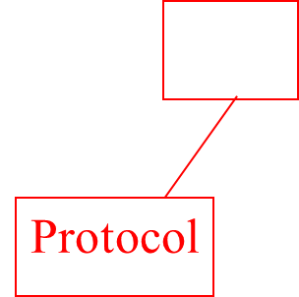
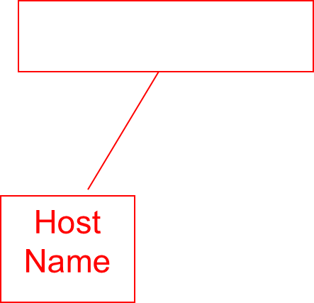
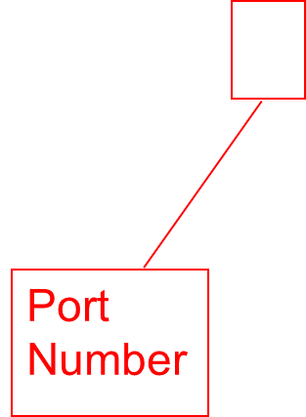
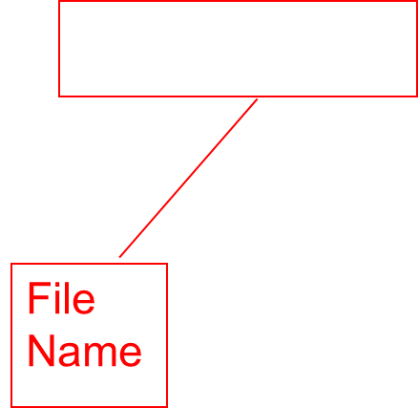
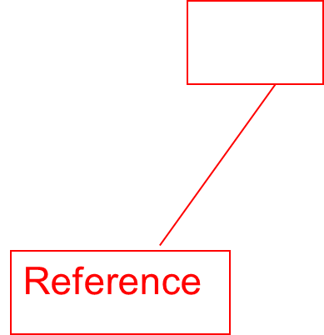
Working with URLs
URL (Uniform Resource Locator) - a reference (an address) to a resource on the Internet
http://www.cs.huji.ac.il:80/~dbi/main.html#notes
Notes:
~Tilde or Wave dash

Slide 12
Creating URLs
The class URL is defined in the package
java.net
Basic constructor:
  URL w3c = new URL("http://www.w3.org/");
Relative links:
  Are created from baseURL + relativeURL
  URL amaya = new URL(w3c, “Amaya/Amaya.html”);
  URL jigsaw = new URL(w3c, “Jigsaw/#Getting”);

Slide 13
Creating URLs (cont.)
The following two are equivalent:
URL dbiNotes = new URL(“http://www.cs.huji.ac.il:80/” + “~dbi/main.html#notes”);
URL dbiNotes = new URL(“http”, “www.cs.huji.ac.il”, 80, “~dbi/main.html#notes”);

Slide 14

Why Do We Need the URL Class?
The main usage of URL is for parsing URLs
  getting the protocol
  getting the host
  getting the port
  getting the file name
  getting the reference

Slide 15
An Example of Parsing a URL
//URLDemo.java
import java.net.*;
public class java_url{
public static void main(String[] args)
{
try{
URL url=new URL("http://net-informations.com/");
System.out.println("Protocol: "+url.getProtocol());
System.out.println("Host Name: "+url.getHost());
System.out.println("Port Number: "+url.getPort()); //output max time show -1
int p=url.getPort();
if(p==-1)
{ int port=url.getDefaultPort();
System.out.println(port);
}
System.out.println("File Name: "+url.getFile());
}catch(Exception e){ System.out.println(e);
}
}
}

Slide 16
Reading From A URL
url
openStream
BufferedReader
InputStreamReader
readLine
Page Content

Slide 17
An Example of Reading From A URL
import java.net.*;
import java.io.*;
public class url_connection {
public static void main(String[] args) throws Exception {
try{
URL url = new URL("http://net-informations.com/");
BufferedReader reader = new BufferedReader(
new InputStreamReader(url.openStream()));
String line;
while ((line = reader.readLine()) != null)
System.out.println(line);
reader.close();
}catch(Exception ex){
System.out.println(ex);
}}}

Slide 18
Socket Programming
This chapter presents key concepts of intercommunication between programs running on different computers in the network
It introduces elements of network programming and concepts involved in creating network applications using sockets
The chapter introduces the java.net package containing various classes required for creating sockets and message communication using two different protocols

Slide 19
Outlines of Presentation
Socket Basics
Socket-based Network Concepts
Client Server Basics
Client Server Algorithm
Socket for Client
Socket for Server

Slide 20
Sockets
A socket is one end-point of a two-way communication link between two programs running on the network
A socket has a binding to a port to which it listens
Java Socket programming is used for communication between the applications running on different JRE.
A socket implementation gives us the ability to read from it and write to it as if it is a file

Slide 21
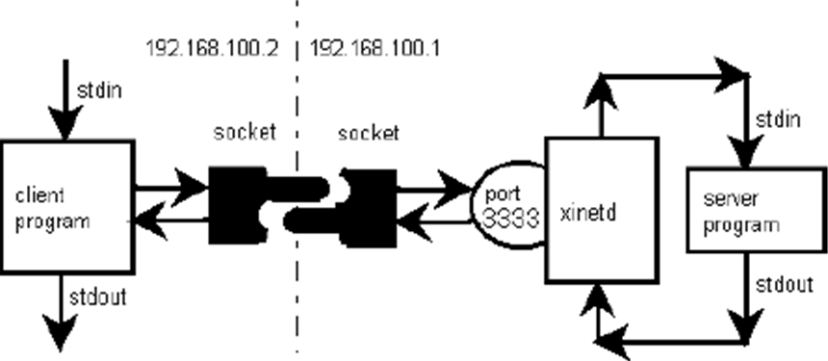
Socket
An interface between an application process and transport layer
  The application process can send/receive messages to/from another application process (local or remote)via a socket
  In computer networking, xinetd (Extended Internet Service Daemon) is an open-source super-server daemon which runs on many operating systems by using port number and manages Internet-based connectivity.
standard input
standard output

Slide 22
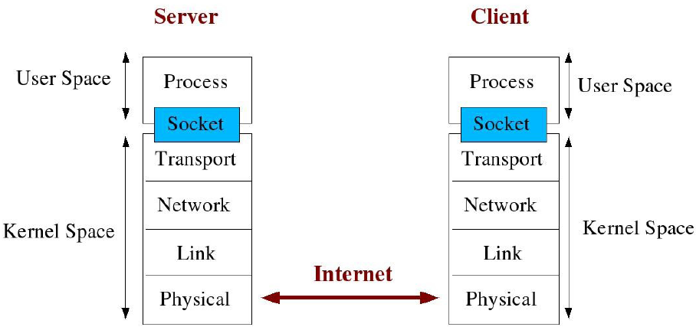
Socket Description
A kernel (Core) is computer program use to connects the application software to the hardware of a computer.
In contrast, user space is the memory area where application software and some drivers execute.
Application
/Message
TCP/UDP
Routing
Error detection and correction
Data rate/ sync
Notes:
The kernel is a computer program at the core of a computer's operating system and generally has complete control over everything in the system.
A kernel connects the application software to the hardware of a computer.
In contrast, user space is the memory area where application software and some drivers execute.

Slide 23
Types of Socket
Stream sockets
  Interface to the TCP (transmission control protocol)
  Rely on TCP to provide reliable two-way connected communication
  The socket type is SOCK_STREAM
Datagram sockets
  Interface to the UDP (user datagram protocol)
  Rely on UDP to provide unreliable two-way connectionless communication
  The socket type is SOCK_DGRAM
Raw sockets
  Interface to the IP (Internet protocol)
  Relay on datagram oriented which are dependent on the interface provided by the protocol
  The socket type is SOCK_RAW

Slide 24
Types of Socket
A socket programming construct can use either UDP or TCP transport protocols
Stream sockets
  Sockets that use TCP for transport are called “stream” sockets
  It provides bidirectional, reliable, sequenced, and unduplicated flow of data with no record boundaries
  Data can be read from and written to these sockets as a byte stream
Datagram sockets
  Sockets that use UDP for transport of packets are called “datagram” sockets
  It supports bidirectional flow of messages and record boundaries in the data are preserved
  It can receive messages in a different order from the sending sequence and can receive duplicate messages

Slide 25
TCP vs. UDP
Transmission Control Protocol (TCP)
  One-to-one
  Connection-oriented
  Reliable
  In-order delivery
  Transmission after Connect
User Datagram Protocol (UDP)
  One-to-one or one-to many
  Connectionless
  Unreliable
  Unordered delivery
  Transmission with destination address

Slide 26
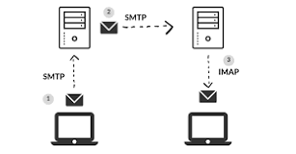
TCP vs. UDP
TCP used for services with a large data capacity, and a persistent connection
While UDP is more commonly used for quick lookups, and single use query-reply actions
Some common examples of TCP and UDP with their default ports:
DNS lookup UDP 53
FTP TCP 21
HTTP TCP 80
POP3 TCP 110
Telnet TCP 23
Notes:
POP3 (Post Office Protocol), IMAP (Internet Message Access Protocol), and SMTP (Simple Mail Transfer Protocol)
IMAP is a better choice than POP. POP is a very old way of receiving mail in an email client.
SMTP is for the sending of emails.

Slide 27
Java Sockets
Part of the java.net package
  Import java.net.*;
Provides two classes of sockets for TCP
  Socket – client side of socket
  ServerSocket – server side of socket
Provides one socket type for UDP
  DatagramSocket

Slide 28
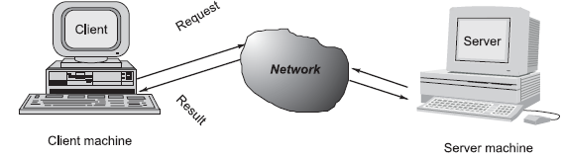
Client/Server Communication
Network-based systems consist of a server , client , and a media for communication
A computer running a program that makes a request for services is called client machine
A computer running a program that offers requested services from one or more clients is called server machine
The media for communication can be wired or wireless network

Slide 29
Client/Server Communication
Sockets are the most widely used programming interfaces for the transport layer protocols
TCP is a connection-oriented protocol that provides a reliable flow of data between two computers
  Example applications that use such services are HTTP, FTP, and Telnet
UDP is a protocol that sends independent packets of data, called datagrams, from one computer to another with no guarantees about arrival and sequencing
  Example applications that use such services include Clock server and Ping
  (Ping is a computer network administration software utility used to test the reachability of a host on an Internet Protocol network)
The TCP and UDP protocols use ports to map incoming data to a particular process running on a computer
Notes:
A ping (Packet Internet or Inter-Network Groper) is a basic Internet program that allows a user to test and verify if a particular destination IP address exists and can accept requests in computer network administration. Or ping is a computer network administration software utility used to test the reachability of a host on an Internet Protocol network.

Slide 30
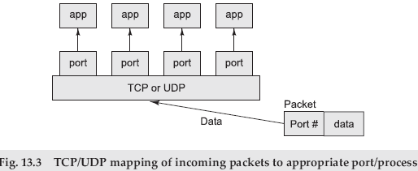
Client/Server Communication

Slide 31
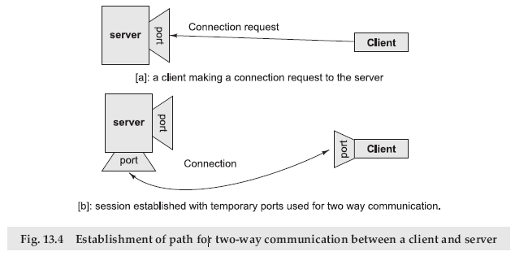
Sockets and Socket-based Communication
Sockets provide an interface for programming networks at the transport layer
Network communication using Sockets is very much similar to performing file I/O
In fact, socket handle is treated like file handle

Slide 32
SOCKET PROGRAMMING AND JAVA.NET CLASS
A socket is an endpoint of a two-way communication link between two programs running on the network
Java provides a set of classes, defined in a package called java.net
Key classes, interfaces, and exceptions in java.net package simplifying the complexity involved in creating client and server programs
The Classes | The Interfaces | Exceptions
URL | ContentHandlerFactory | BindException
URLConnection | FileNameMap | ConnectException
URLStreamHandler | SocketImplFactory | SocketException
URLEncoder | URLStreamHandlerFactor | ProtocolException
Notes:
A FileNameMap is an interface returned by methods of a class that understands filetypes.
SocketImplFactory interface defines a factory for socket implementations. It is used by the classes Socket and ServerSocket to create actual socket implementations.

Slide 33
TCP/IP SOCKET PROGRAMMING
The two key classes from the java.net package used in creation of server and client programs are
  ServerSocket
  Socket
A server program creates a specific type of socket that is used to listen for client requests (server socket)
In the case of a connection request, the program creates a new socket through which it will exchange data with the client using input and output streams
The socket abstraction is very similar to the file concept
Developers have to open a socket, perform I/O, and close it

Slide 34
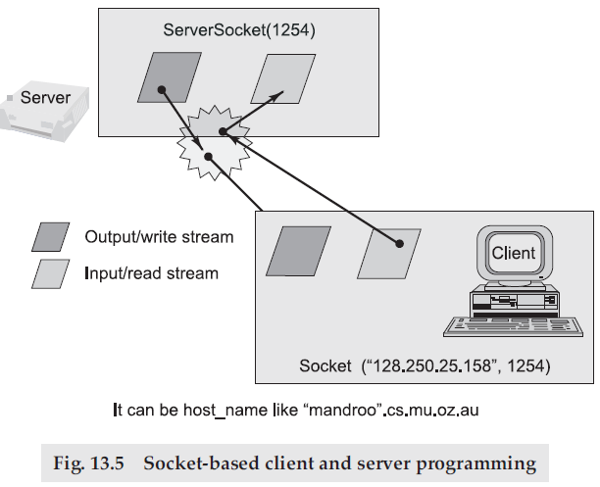
TCP/IP SOCKET PROGRAMMING

Slide 35
Steps for Creating a Simple Server Program
Open the Server Socket
  ServerSocket server = new ServerSocket( PORT );
Wait for the Client Request
  Socket client = server.accept();
Create I/O streams for communicating to the client
  DataInputStream is = new DataInputStream(client.getInputStream());
  DataOutputStream os = new DataOutputStream(client.getOutputStream());
Perform communication with client
  Receive from client: String line = is.readLine();
  Send to client: os.writeBytes(“Hello\n”);
Close socket
  client.close();
Java OutputStream class:
ByteArrayOutputStream
FileOutputStream
PipedOutputStream
BufferedOutputStream
FilterOutputStream
DataOutputStream
PrintStream
ObjectOutputStream

Slide 36
Server Program
An example program illustrating creation of a server socket, waiting for client request, and then responding to a client that requested for connection by greeting
//SimpleServer.java: A simple //server program
import java.net.*;
import java.io.*;
public class server1 {
public static void main(String args[]) throws IOException {
// Register service on port 2992
ServerSocket s =
new ServerSocket(2992);
Socket s1=s.accept();
//Wait and accept a connection
//Get a communication stream //associated
//with the socket
OutputStream s1out = s1.getOutputStream();
DataOutputStream dos =
new DataOutputStream (s1out);
// Send a string!
dos.writeUTF("Hi there");
// Close the connection,
//but not the server socket
dos.close();
s1out.close();
s1.close();
}
}
Notes:
Is UTF (Unicode Translation Format) it is character encoding-8 and ASCII same?
For characters represented by the 7-bit ASCII character codes, the UTF-8 representation is exactly equivalent to ASCII, allowing transparent round trip migration. Other Unicode characters are represented in UTF-8 by sequences of up to 6 bytes

Slide 37
Steps for Creating a Simple Client Program
Create a Socket Object
  Socket client = new Socket(server, port_id);
Create I/O streams for communicating with the server
  is = new DataInputStream(client.getInputStream());
  os = new DataOutputStream(client.getOutputStream());
Perform I/O or communication with the server
  Receive data from the server: String line = is.readLine();
  Send data to the server: os.writeBytes(“Hello\n”);
Close the socket when done
  client.close();

Slide 38
Client Program
An example program illustrating establishment of connection to a server and then reading a message sent by the server and displaying it on the console
// SimpleClient.java: A simple client //program
import java.net.*;
import java.io.*;
public class client1 {
public static void main(String args[]) throws IOException {
//Open your connection to a server, at //port 2992
Socket s1 = new Socket("127.0.0.1",2992);
//Get an input file handle from the //socket and read the input
InputStream s1In = s1.getInputStream();
DataInputStream dis = new DataInputStream(s1In);
String st = new String (dis.readUTF());
System.out.println(st);
//When done, just close the connection s1In.close();
s1.close();
}}
The remain part use to send msg to server………….
OutputStream s1out = s1.getOutputStream();
DataOutputStream dos = new DataOutputStream (s1out);
// Send a string!
dos.writeUTF("Hi there");
// Close the connection, but not the
//server socket
dos.close();
s1out.close();
s1.close();
}
}

Slide 39
UDP Socket Programming
TCP guarantees the delivery of packets and preserves their order on destination
Sometimes these features are not required and since they do not come without performance costs, it would be better to use a lighter transport protocol
This kind of service is accomplished by the UDP protocol which conveys datagram packets

Slide 40

UDP Socket Programming
Datagram packets are used to implement a connectionless packet delivery service supported by the UDP protocol
Each message is transferred from source machine to destination based on information contained within that packet
That means, each packet needs to have destination address and each packet might be routed differently, and might arrive in any order
Packet delivery is not guaranteed
  The format of datagram packet is

Slide 41
UDP Socket Programming
Java supports datagram communication through the following classes
  DatagramPacket
    The class DatagramPacket contains several constructors that can be used for creating packet object
      DatagramPacket(byte[] buf, int length, InetAddress address, int port);
  DatagramSocket
    The class DatagramSocket supports various methods that can be used for transmitting or receiving data a datagram over the network
      void send(DatagramPacket p)
        Sends a datagram packet from this socket
      void receive(DatagramPacket p)
        Receives a datagram packet from this socket

Slide 42
UDP Server Program
import java.io.*;
import java.net.*;
class UDPServer
{
public static void main(String args[]) throws Exception
{
DatagramSocket serverSocket = new DatagramSocket(9876);
byte[] receiveData = new byte[1024];
byte[] sendData = new byte[1024];
while(true)
{
DatagramPacket receivePacket = new DatagramPacket(receiveData, receiveData.length);
System.out.println("Waiting...... " ); serverSocket.receive(receivePacket);
System.out.println("Data Received...... " );
String sentence = new String( receivePacket.getData());
System.out.println("RECEIVED: " + sentence);
Thread.sleep(3000)
; InetAddress IPAddress = receivePacket.getAddress();
int port = receivePacket.getPort();
String capitalizedSentence = sentence.toUpperCase();
sendData = capitalizedSentence.getBytes();
DatagramPacket sendPacket =
new DatagramPacket(sendData, sendData.length, IPAddress, port);
serverSocket.send(sendPacket);
}
}
}

Slide 43
UDP Client Program
import java.io.*;
import java.net.*;
class UDPClient
{
public static void main(String args[]) throws Exception
{
BufferedReader inFromUser =
new BufferedReader(new InputStreamReader(System.in));
DatagramSocket clientSocket = new DatagramSocket();
InetAddress IPAddress = InetAddress.getByName("localhost");
byte[] sendData = new byte[1024];
byte[] receiveData = new byte[1024];
String sentence = inFromUser.readLine();
sendData = sentence.getBytes();
DatagramPacket sendPacket = new DatagramPacket(sendData, sendData.length, IPAddress, 9876);
clientSocket.send(sendPacket);
DatagramPacket receivePacket = new DatagramPacket(receiveData, receiveData.length);
System.out.println("Waiting...... " );
clientSocket.receive(receivePacket);
System.out.println("Data Received...... " );
String modifiedSentence = new String(receivePacket.getData());
System.out.println("FROM SERVER:" + modifiedSentence);
clientSocket.close();
}
}

